Slide 1
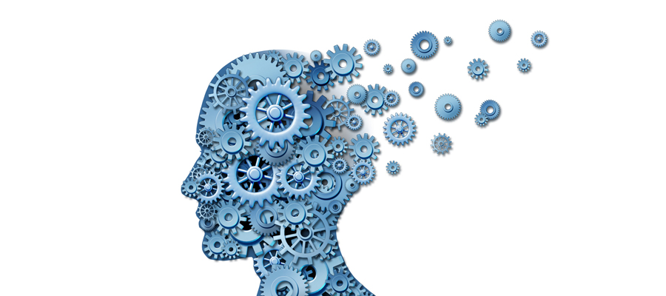
Predicting Alzheimer Disease
Presented by : Shirly Ohanona
11.6.2018
Source: Kaggle-MRI and Alzheimers
https://www.kaggle.com/jboysen/mri-and-alzheimers

Slide 2
Introduction
Dementia is a general term for a decline in mental ability severe enough to interfere with daily life. Memory loss is an example. Dementia is not a specific disease. It’s an overall term that describes a group of symptoms associated with a decline in memory or other thinking skills severe enough to reduce a person’s ability to perform everyday activities.
The most common type of dementia is Alzheimer’s disease which makes up 50% to 70% of cases.
This is a neurological disorder in which the death of brain cells causes memory loss and cognitive decline.
Diagnosis of dementia: There is no one test to determine if someone has dementia. Doctors diagnose Alzheimer’s and other types of dementia based on a careful medical history, a physical examination, laboratory tests, and the characteristic changes in thinking, day-to-day function and behavior associated with each type.

Slide 3
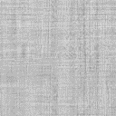
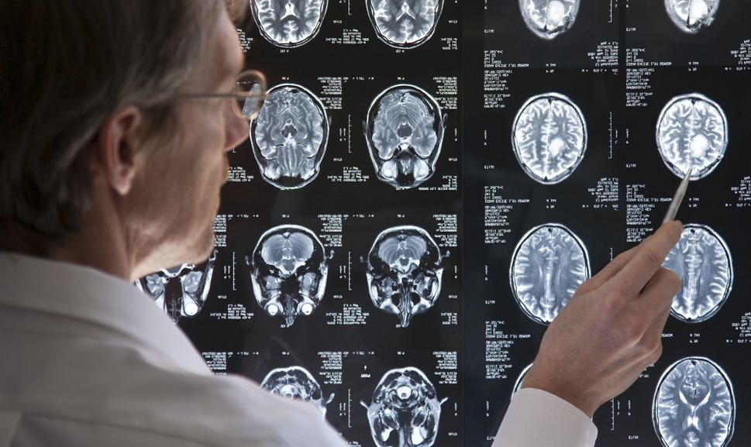
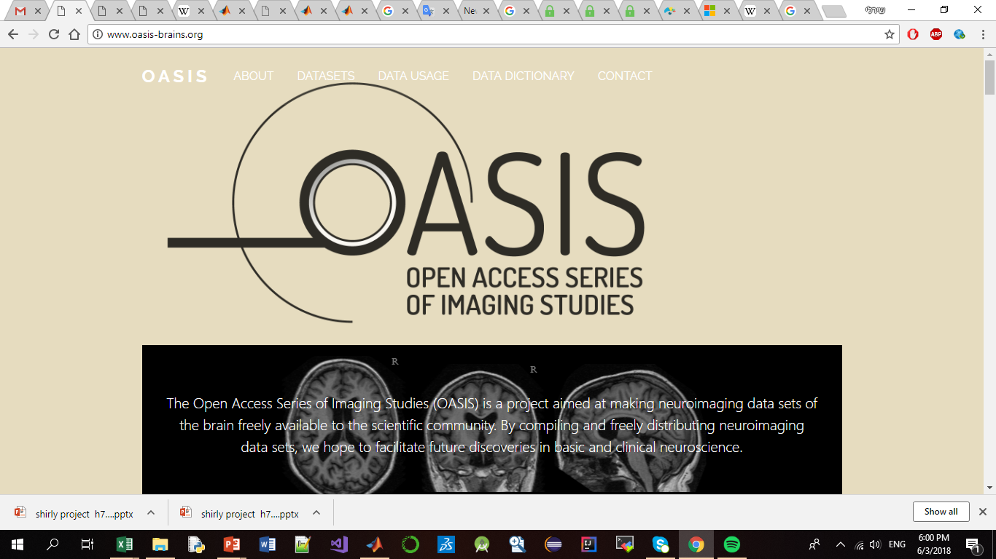
The Open Access Series of Imaging Studies (OASIS) is a project aimed at making MRI data sets of the brain freely available to the scientific community. By compiling and freely distributing MRI data sets, we hope to facilitate future discoveries in basic and clinical neuroscience. OASIS is made available by the Washington University Alzheimer’s Disease Research Center, Dr. Randy Buckner at the Howard Hughes Medical Institute at Washington University School of Medicine, and the Biomedical Informatics Research Network (BIRN).

Slide 4
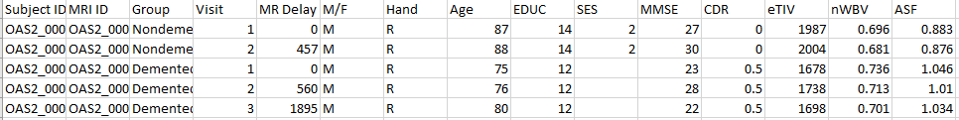
DATA
Longitudinal MRI Data in Nondemented and Demented Older Adults: This set consists of a longitudinal collection of 150 subjects aged 60 to 96. Each subject was scanned on two or more visits, separated by at least one year for a total of 373 imaging sessions
(training set and cross validation set (70%,30%)

Slide 5
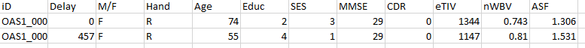
Cross-sectional MRI Data in Young, Middle Aged, Nondemented and Demented Older Adults: This set consists of a cross-sectional collection of 416 subjects aged 18 to 96.
(test set)

Slide 6
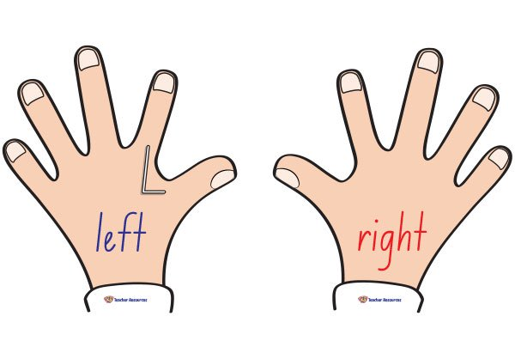
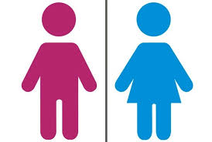

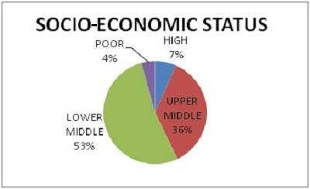
General Info
Subject.ID
Group (Converted / Demented / Nondemented)
Visit - Number of visit
Demographics Info
M.F - Gender
Hand - Handedness ( all subjects were right-handed)
Age
EDUC - Years of education
SES - Socioeconomic status categories from 1 (highest status) to 5 (lowest status)

Slide 7
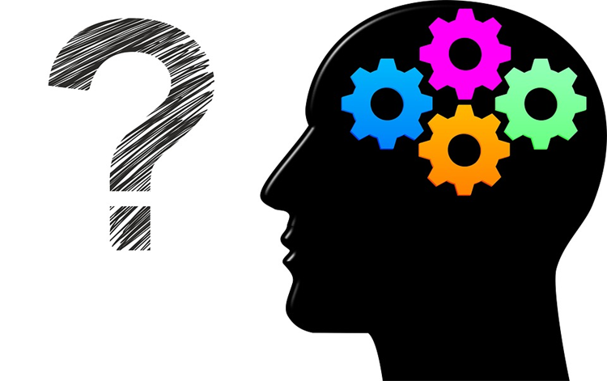
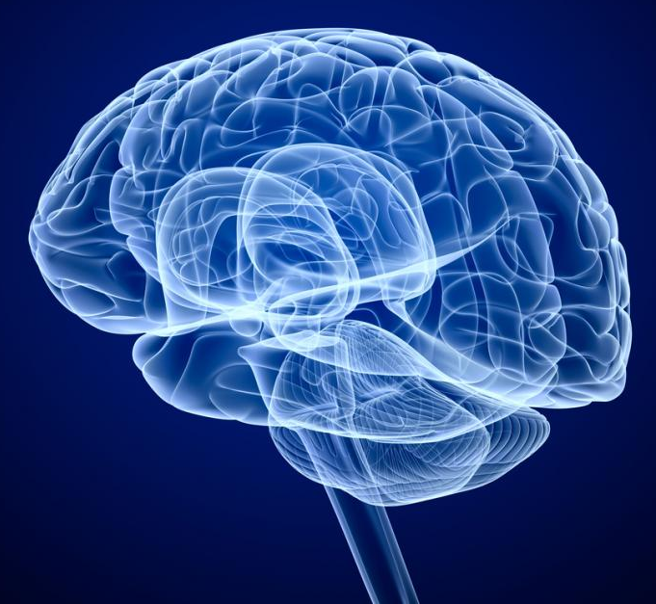
Clinical Info
MMSE - Mini-Mental State Examination score
(range is from 0 = worst to 30 = best)
CDR - Clinical Dementia Rating
(0 = no dementia, 0.5 = very mild AD, 1 = mild AD, 2 = moderate AD)
Derived anatomic volumes
eTIV - Estimated total intracranial volume.
nWBV - Normalized whole-brain volume.
ASF - Atlas scaling factor.

Slide 8
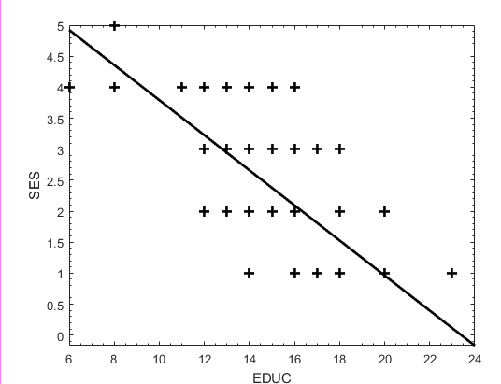
Data manipulation
* All subjects were right-handed so I dropped this column
* The column SES had missing values, so I replace
them with median for that column
(according to the EDUC column)-> Data
Another solution:
Simply remove the line with the missing values -> Without_NAN
* Change Converted to Demented
* Change M/F to 0/1 using dummy variables

Slide 9
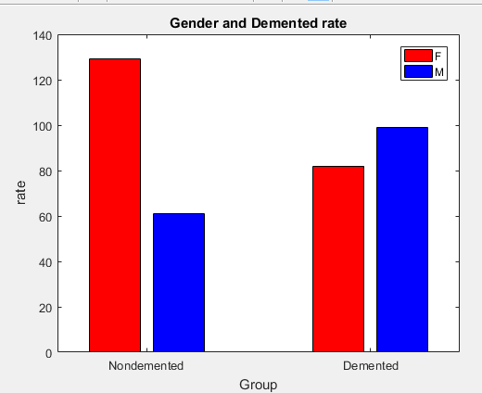
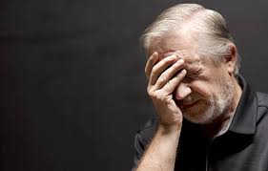
Men are more likely with dementia than women.
(There are 211 women and 160 men)

Slide 10
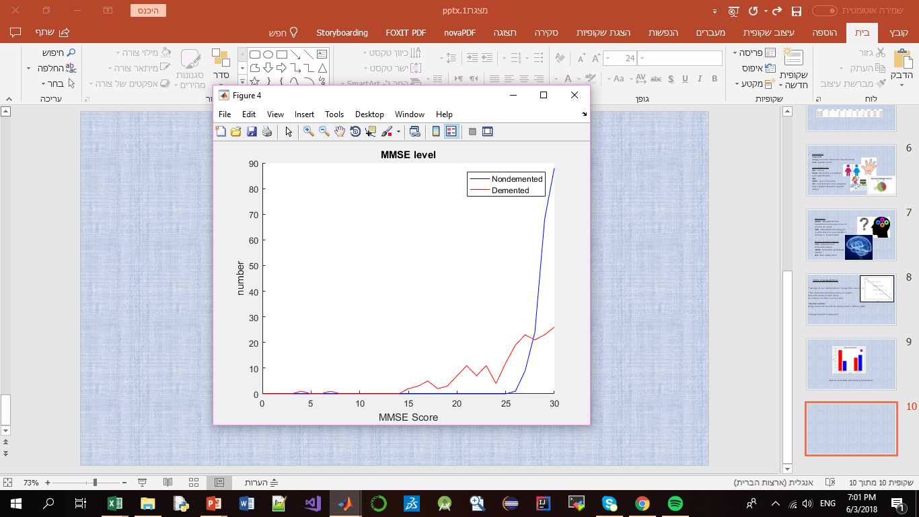
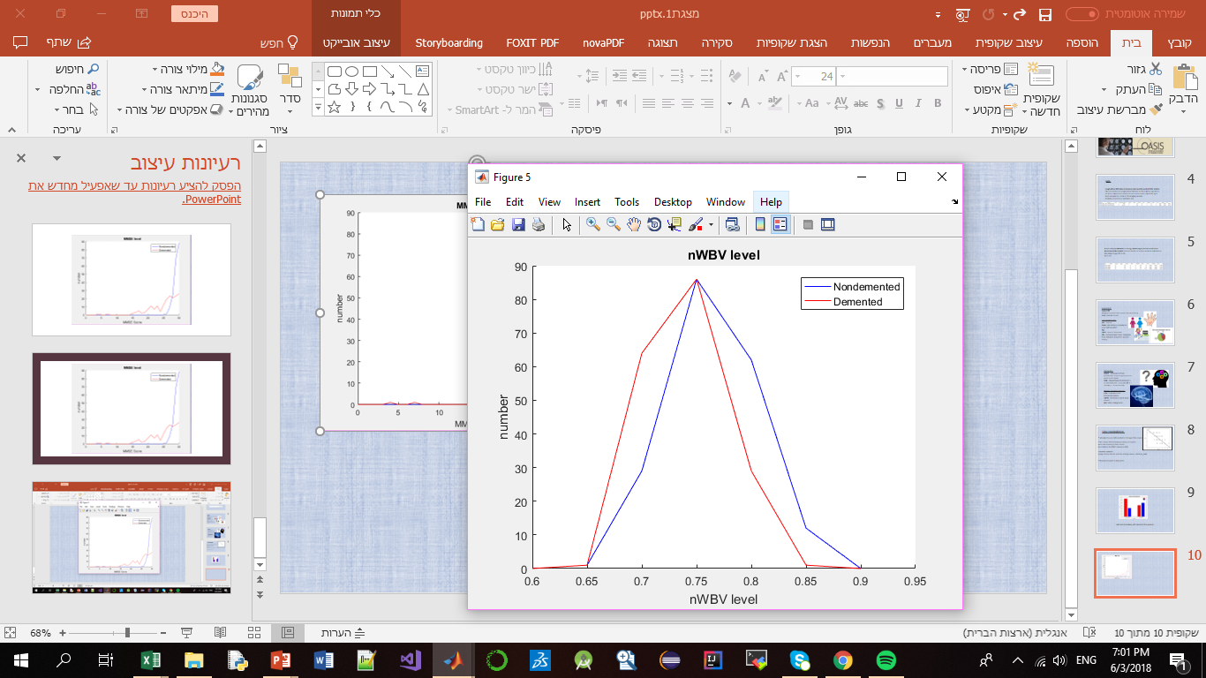
Nondemented group has higher brain volume ratio than Demented group. This is assumed to be because the diseases affect the brain to be shrinking its tissue.
Nondemented group got much more higher MMSE scores than Demented group

Slide 11
Results (Data)
Algorithm | Recall | Precision | F1
KNN | 0.8806 | 0.9833 | 0.9291
Linear Regression | 0.9783 | 0.9184 | 0.9474
Logistic Regression | 0.9333 | 0.9655 | 0.9492
NN | 0.8667 | 0.9811 | 0.9204
SVM | 0.8824 | 0.9783 | 0.9278
Decision Tree | 0.9074 | 0.9074 | 0.9074

Slide 12
Learning on the Cross-sectional Data using the models:
Logistic Regression- find a model (function) that classifies a given value to one or more categories .
NN- can learn on their own and adapt to changing conditions, There may be interconnections between features that can be used by the neural network.
Decision Tree – fast, Obtain similar and sometimes better accuracy compared to other models, Simple and easy.

Slide 13
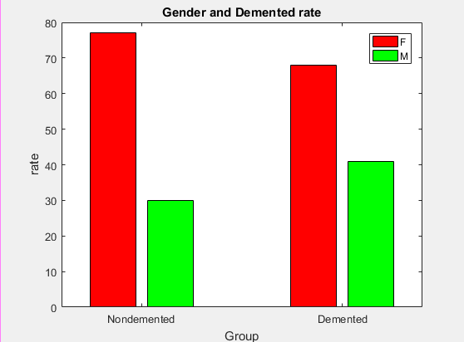
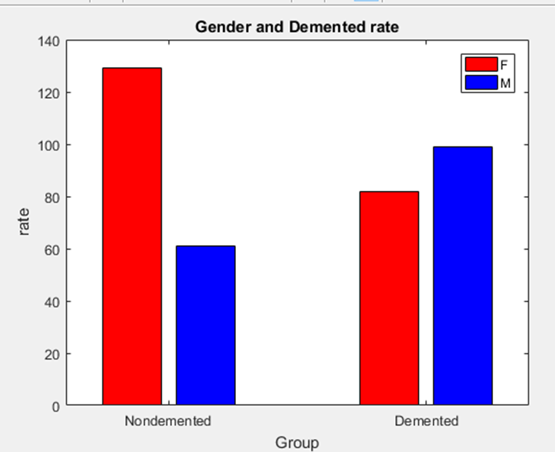
Analysis and conclusions
There are 145 women and 71 men
~75 women are healthy
~70 women are sick
~30 men are healthy
~40 men are sick

Slide 14
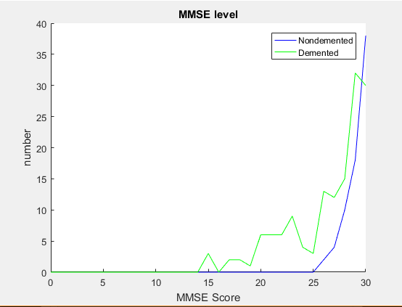
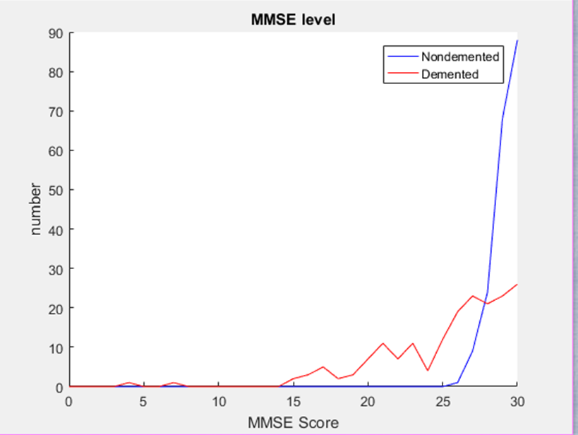
Nondemented group got much more higher MMSE scores than Demented group

Slide 15
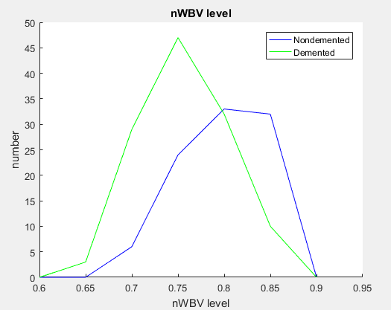
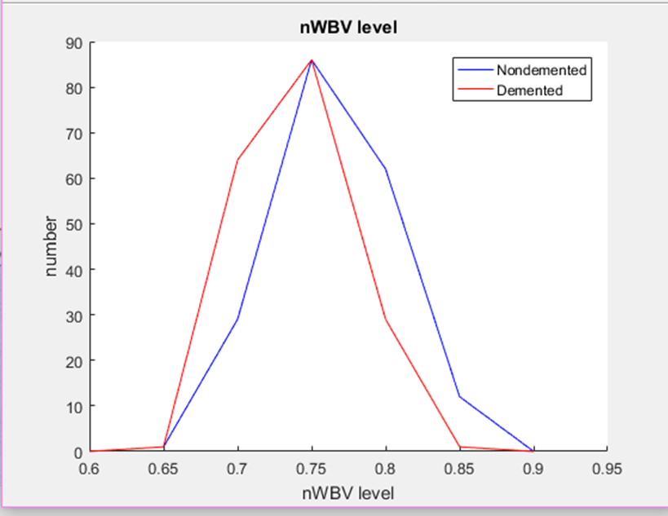
Nondemented group has higher brain volume ratio than Demented group. This is assumed to be because the diseases affect the brain to be shrinking its tissue.

Slide 16
Conclusion
The selected features allowed me to build good models that prove themselves.
The labels were very good - even too good.
It may be worthwhile to take additional features and then, maybe, the picture will look different.

